Slide 1
NCIMS Conference
April 12, 2025
Symposium
Food Defense Study Committee
Minneapolis, MN
Antone Mickelson
Chair

Slide 2
1954 Civil Defense Outreach
Notes:
Stephen Beam “Sometimes our grandparents were dealing with the same or similar issues, but called them different things. Biological warfare instead of Agroterrorism. Civil Defense instead of Homeland Security.”

Slide 3
NCIMS Symposium: Food Defense Study Committee
Committee Members:
Industry:
Antone Mickelson – Chair
Amanda Rife – Vice Chair
Alex Beard – DFA
Clay Detlefsen, Esq – NMPF
Pat Gorden, DVM – Iowa State
State Regulatory:
Chris Hylkema – New York
Dr. Steve Beam – California
Harris Hollingsworth – Texas
Brian Wise – Ohio
Jimmy Williamson – South Carolina
FDA:
Dr. Beth Briczinski
Jon Woody
Curt Griner
Contributors:
Ryan Newkirk - FDA
Miquela Hanselman - NMPF
Alyssa Snyder - LOL
Tim Anderson - WI
Neil Bendixen – DFA
Michelle Carter – NDA

Slide 4
NCIMS Symposium - Food Defense Study Committee The why and the ask:
In developing the Food Safety Modernization Act (FSMA) final rule “Mitigation Strategies to Protect Food Against Intentional Adulteration,” FDA decided that the most appropriate way to address concerns regarding intentional adulteration on dairy farms in the near term is to engage with key stakeholders, specifically the National Conference on Interstate Milk Shipments (NCIMS), to further dialogue and collaborate on research to develop and identify strategies that are protective and practical for dairy farms. The Committee initiated work in May 2021 and is in the final stages of completing its work. The final draft report describes and summarizes the Committee’s activities and provides best practice options that farms may choose to voluntarily adopt, or adopt tailored variations thereof, to further protect milk on farm.

Slide 5
NCIMS Symposium - Food Defense Study Committee
Charge:
Identify potential mitigation strategies that could be implemented in a dairy farm environment to reduce vulnerability to intentional adulteration;
Evaluate potential mitigation strategies to determine if they are viable to implement on a dairy farm, taking into account current dairy farming practices and the impact particular mitigation strategies may have on farm operations; regulatory compliance with existing state, local, or federal requirements; and perceived feasibility and estimated costs involved in the implementation of those strategies; and
Identify food defense awareness training activities relevant to dairy farms and identify potential gaps in those trainings.

Slide 6
NCIMS Symposium - Food Defense Study Committee Major activities:
Reviewed a subset of existing information:
US DOT, 2004,
Mitigation Strategies to Protect Food Against Intentional Adulteration: Guidance for Industry, Chapter 3 Mitigation Strategies for Actionable Process Steps (FDA 2019)
FDA Food Mitigation Strategies Database (FMSD; FDA, 2024)

Slide 7
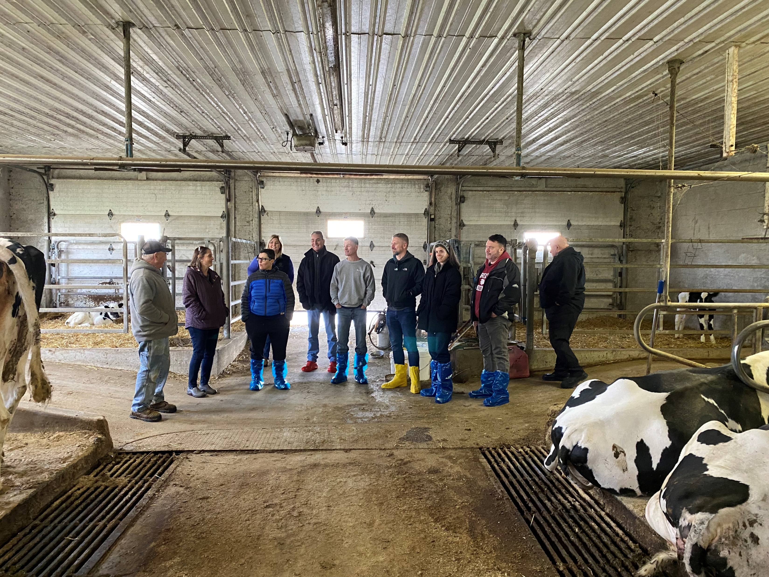
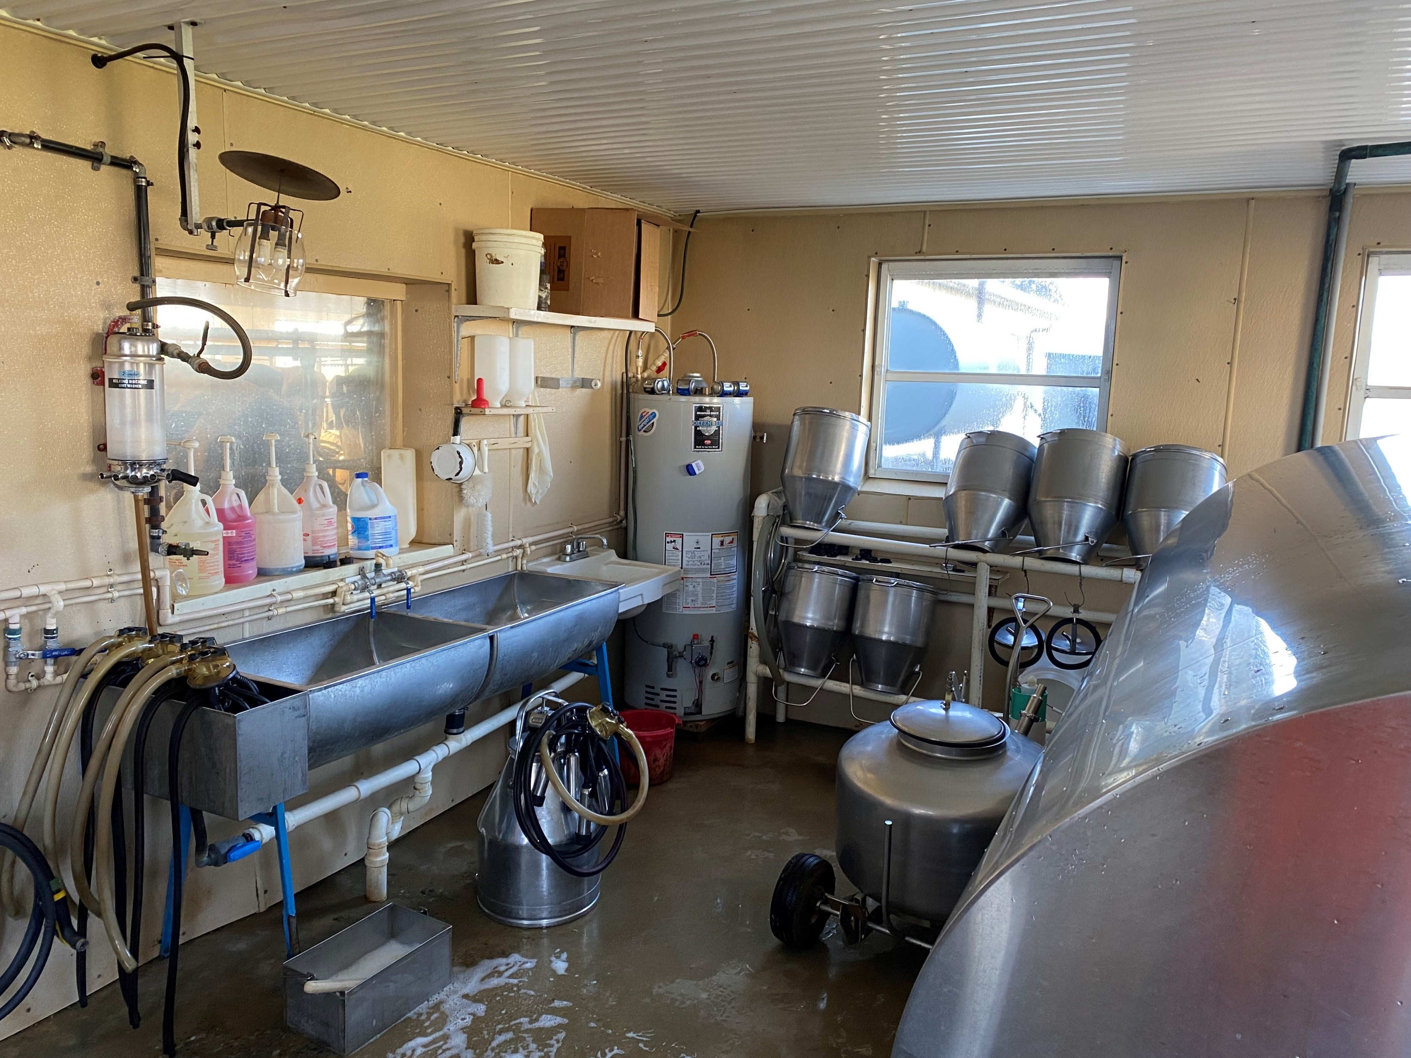
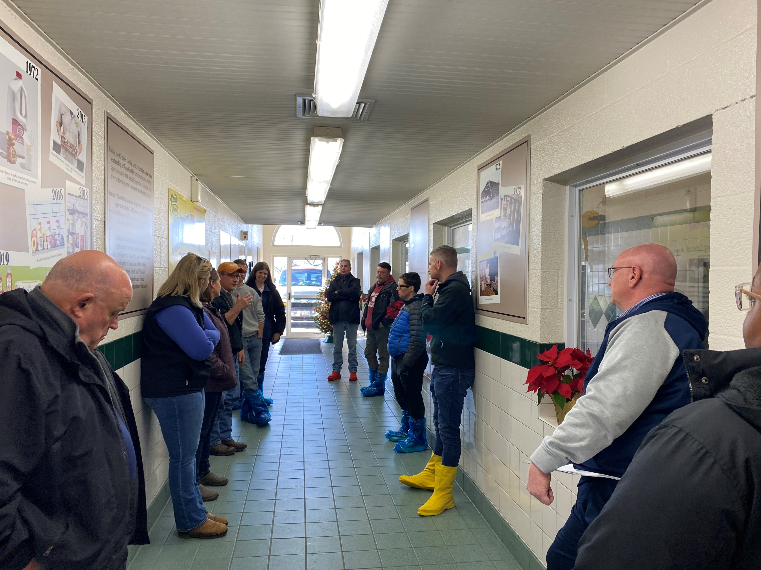
NCIMS Symposium - Food Defense Study Committee Major activities:

Slide 8
NCIMS Symposium - Food Defense Study Committee Identify Best Practices:
Evaluated and reviewed 42 recommendations
Potentially 16 as recommendations Feasible, 18 not applicable or duplicative
Table 1. Strategies Deemed Potentially Applicable, Feasible, and Effective
Maximize visibility of operations, equipment, and locations (e.g., install mirrors, light adequately, keep area clear of visual obstructions)
Restrict access immediately around the step to authorized personnel
Restrict access of drivers to specified locations
Restrict access to equipment and controls to authorized personnel
Restrict access to ingredients, products, and/or cargo to authorized personnel
Restrict access to openings or access points (e.g., to bins, tanks, vats, ports/valves, inspection points, system openings) to authorized personnel
Restrict access to transport operations to authorized personnel (bulk milk only)
Restrict operations to authorized personnel
Store products in a secured location
Use automated equipment (e.g., for dispensing, injection, incorporating, packing) to restrict access to product
Use locks to secure location, equipment, and controls when not in use or unattended (e.g., use tamper-proof containers, locks)
Use personnel (e.g., guards, supervisors, trusted employees) for visual observation
Use surveillance equipment (e.g., cameras) to increase observation
Use peer monitoring (e.g., buddy system) to supervise deliveries
Install "No Trespassing" signs for deterrent effect
Visually inspect equipment, equipment components, and supplies prior to use
Table 1 is not exhaustive. (Sullivan and Artino, 2013)

Slide 9
NCIMS Symposium - Food Defense Study Committee Identify Best Practices:
General FARM Security Recommendations
The FARM Biosecurity Reference Manual contains general farm security standards (NMPF, 2022). Many of these standards translate to steps that dairy farmers and visitors should take to protect the milk supply and dairy herds from intentional adulteration.
Best Practices for General Farm Security
Have proper lighting, motion detectors, and security cameras for offices, livestock housing, chemical, and milk storage areas.
Post signs guiding people to where they can and cannot go on your farm.
Designated Parking Area
A simple and effective vehicle control measure is to have a designated parking area on the perimeter, away from animal areas.
Point of Entry Best Practices
Restrict access through use of a limited number of access points.
Each point of entry should be clearly marked with signs written in languages understood by all who need to enter. Signs should include who to contact prior to entry.
Labeled Premises Map
Security plans with a labeled premises map provide a visual guide to layout,
Permanent Written or Electronic Chemical and Drug Records Inventory are Maintained

Slide 10
NCIMS Symposium - Food Defense Study Committee Identify Best Practices to consider:
Develop Farm Comprehensive Emergency Action Plan Guidance
Continuing Education Requirement
All workers are recommended to participate in some form of security awareness or continuing education (CE) and keep records of this training.
Documentation of a security plan including the context of food defense.
Communication of food defense principles in the FARM Program.
Identification of a translator, if necessary for the dairy farm.
Distribution of signage conveying food defense principles and practices.
Identification of local law enforcement and first responder contacts.
Identification of proper SOPs for engagement of law enforcement and first responders.
Development of a dedicated security manual for farms that includes the food defense context. This security manual could be linked to the biosecurity module.

Slide 11
NCIMS Symposium - Food Defense Study Committee Summary:
The Committee recommends that dairy farms:
Review the mitigation strategies listed in Table 1,
Adopt those that suit their operations,
Incorporate training programs to improve food defense awareness.
The committee recognizes that, in some cases, farms may already have sufficient mitigation strategies in place which would not warrant any further adoptions from Table 1 or additional training.
Regular evaluation and adjustment of these strategies will ensure they remain effective in preventing intentional adulteration.
This report provides actionable insights and recommendations for dairy farmers to strengthen their food defense practices.
By adopting these strategies and participating in ongoing training, dairy farms can enhance the security of their milk supply and safeguard against intentional adulteration.
Table 1 is not an exhaustive list of potential mitigation strategies that could protect milk on farm. Farms may design, identify, or choose strategies not contained in the list, if additional protective actions are needed.

Slide 12
NCIMS Symposium - Food Defense Study Committee Next Steps:
January 30,2025 NCIMS Board Meeting
The NCIMS Board did not accept the Food Defense report as presented.
The direction was given:
Add data to the report showing the number of intentional adulteration incidents since the signing of FSMA in 2011.
Additional language should be added to the report from the Food Safety Modernization Act (FSMA) highlighting the reliance on risk-based and science-based evidence.
Highlight a review of training materials for farmers embedded in other programs.
The committee requests an audience with our FDA partners to hear about their vision of next steps if the report is accepted by NCIMS Exec Board.
The Committee will revisit the NCIMS Executive Board to determine next steps

Slide 13
NCIMS Symposium - Food Defense Study Committee References:
References
FDA (Food and Drug Administration). (2016). Mitigation Strategies to Protect Food Against Intentional Adulteration. Final Rule. Federal Register, 81(103), 34165-34223.
FDA (Food and Drug Administration). (2019). Draft Guidance for Industry: Mitigation Strategies to Protect Food Against Intentional Adulteration. https://www.fda.gov/media/113684/download.
FDA (Food and Drug Administration). (2024). Food Defense Mitigation Strategies Database: https://www.fda.gov/food/food-defense-tools/mitigation-strategies-database.
NPMF (National Milk Producers Federation). (2022). Everyday Biosecurity Reference Manual Version 1. https://nationaldairyfarm.com/wp-content/uploads/2022/10/FARM_Everyday-Biosecurity-Version-1_Reference-Manual_FINAL_101822_Web_pages.pdf.
Sullivan, GM and Artino, AR. (2013). Analyzing and Interpreting Data from Likert-Type Scales. J Grad Medical Educ. 54(4), 541-542. https://doi.org/10.4300/JGME-5-4-18.
US DOT (United States Department of Transportation. (2004). Security of Milk Transport in the United States Project Final Report. (For Official Use Only)

Slide 14
NCIMS Proposal #207
Establishes a study committee to review Sections 8, 13 and 14 of the PMO Sec 8 – Animal Health Sec 13 – Personnel Health Sec 14 – Procedure when infection or High Risk of infection is discovered The Committee will align the PMO with biosecurity Best Management Practices The NCIMS Food Defense Study Committee has been charged with this work and will report back at the 2025 NCIMS Conference

Slide 15
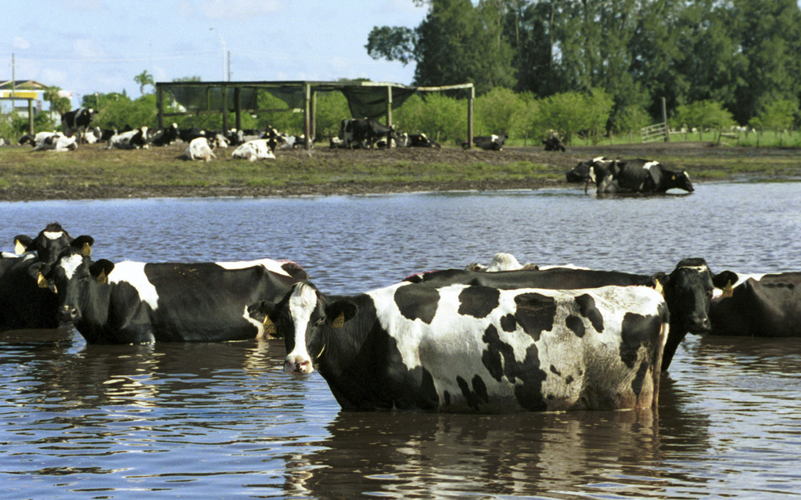
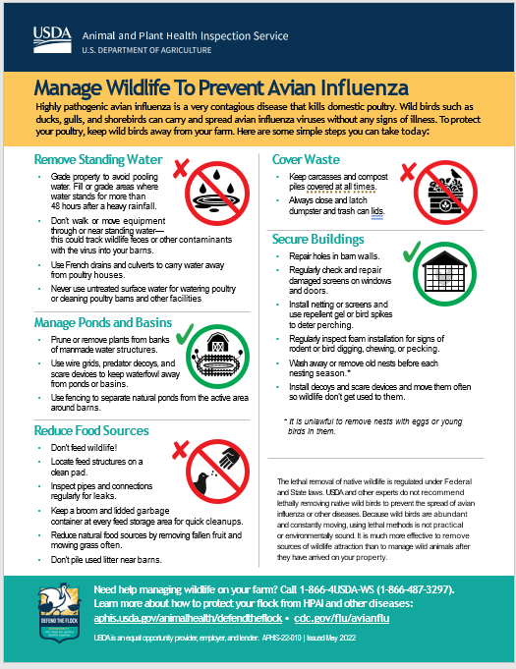
NCIMS Proposal #207
Establishes a study committee to review Sections 8, 13 and 14 of the PMO
Sec 8 – Animal Health
Sec 13 – Personnel Health
Sec 14 – Procedure when infection or High Risk of infection is discovered

Slide 16
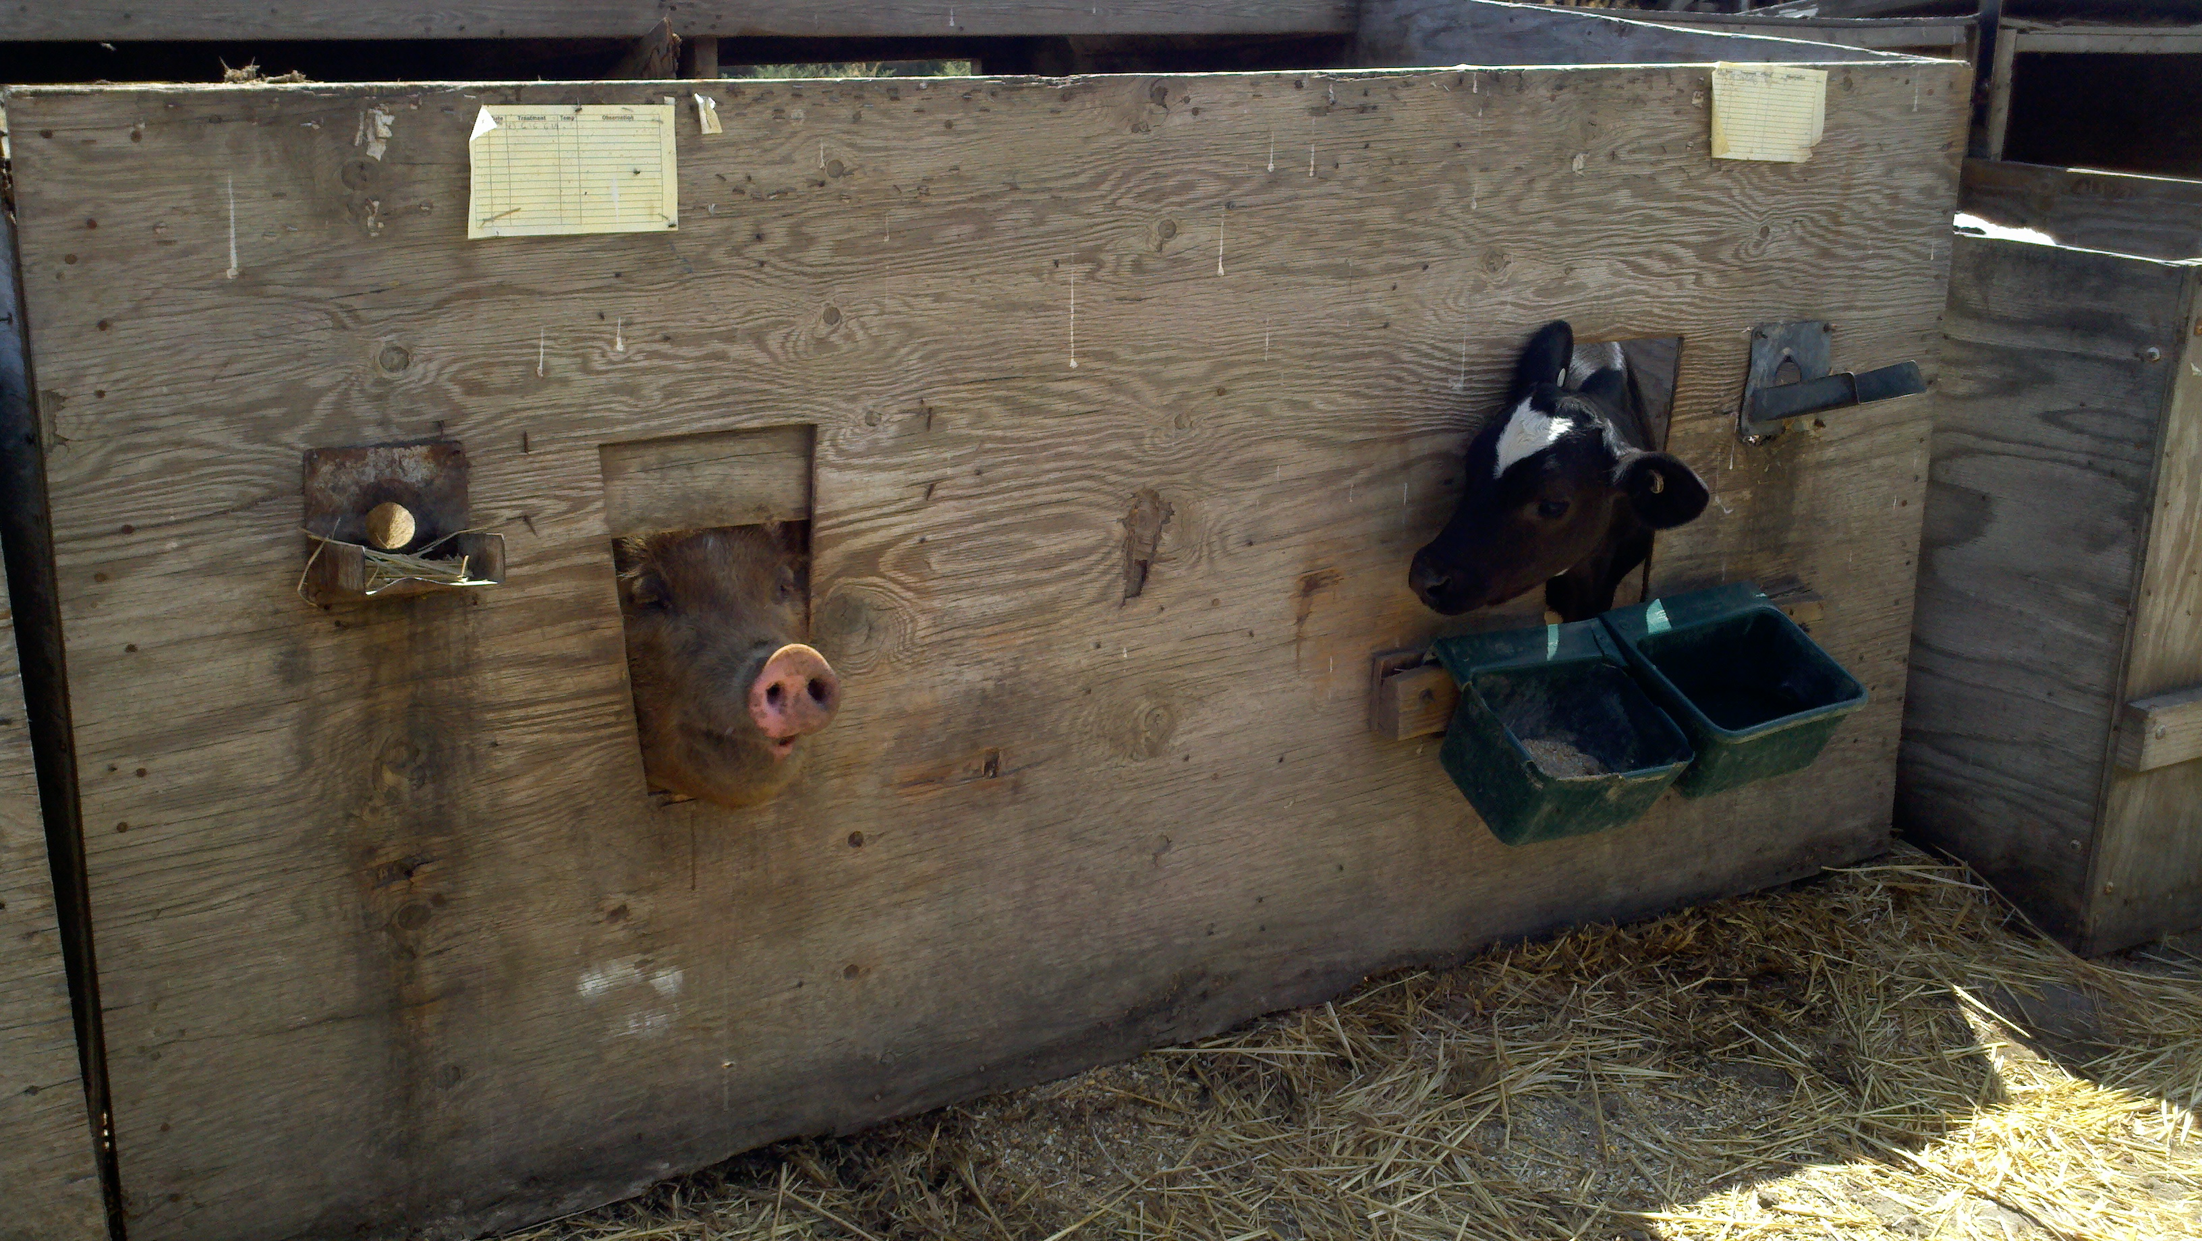
Thank you!
Antone.Mickelson@nwdairy.com
509-952-6455

