Slide 1
Strained Yogurt-Cream After Culturing Study Committee
NCIMS 2025

Slide 2
Charge of the committee
The NCIMS study committee shall examine the issue of pasteurization of skim milk and cream separately and subsequently adding the cream to the cultured and strained skim milk to adjust the fat level, practices currently used to manufacture high protein, strained yogurts. The study committee shall consider multiple options, which could include drafting a proposal to establish parameters of food safety specific to these current industry practices and/or a proposal with clarifying edits to allow for these current industry practices.

Slide 3
Committee Members
Chair- Heather Spraker, Cornell University
Vice Chair- E.B. Flory, VT
Regulatory Members:
Brian Wise, OH
Mat Meyers, ID
Kim King, WA
Karie Williams, PA
Industry Members:
Non-Voting Members
Sam Alcaine, PhD, IDFA
Miquela Hanselman, NMPF
Lisa Dame, Lactalis
Matthew Graziose, Chobani
FDA Technical Advisor-Curtis Griner
FDA Consultant- Beth Briczinski, PhD

Slide 4
Timeline
4/13/2023
New updated SOI issued
10/30/2024
NCIMS board approval of Committee members
12/16/2024- 4/4/2025
Met as a committee 6 times virtually
9/2024
Creation of Strained Yogurt Study Committee

Slide 5
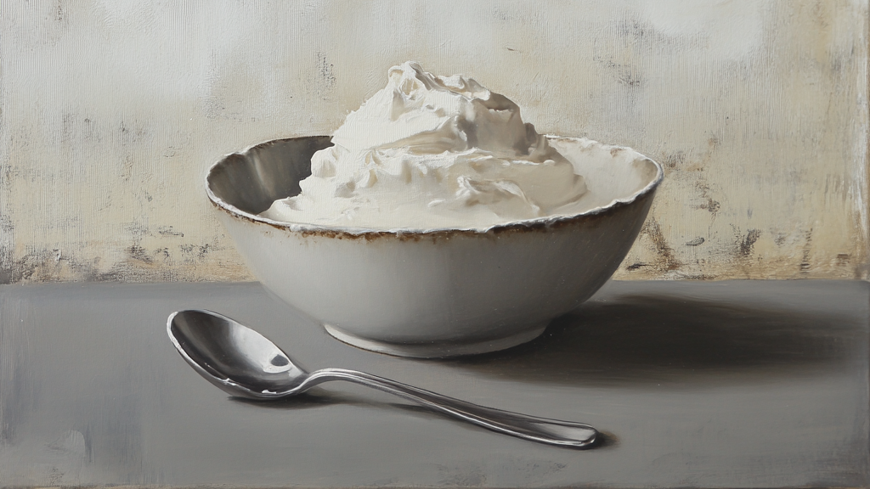
Strained Yogurt Production
Cliff Notes

Slide 6
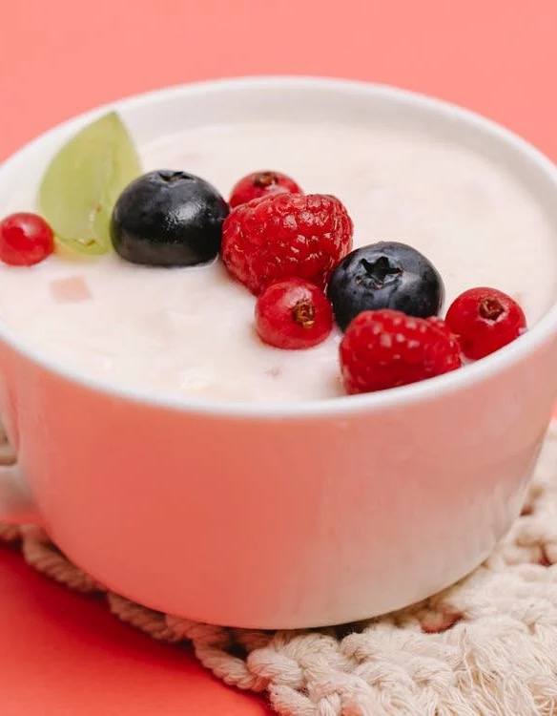
Strained Yogurt in the US Market
Greek yogurt launched in US in 1998, major growth starting in 2007.
62% of yogurt is Greek/strained yogurt.
Over 50% of the Greek/strained yogurt market use centrifugal separation.
All Greek/strained yogurts meet the SOI requirement of pH 4.6 within 24 hours of packaging.

Slide 7
PMO 16p Part 2.
All milk and/or milk products, i.e., milk solids, whey, nonfat dry milk, condensed milk, cream, skim milk, etc., eggs, egg products, cocoa, cocoa products, emulsifiers, stabilizers, vitamins and liquid sweeteners shall be added prior to pasteurization. Provided, ingredients which may be added after pasteurization are those flavoring ingredients and other ingredients which have been found to be safe and suitable and which include:
a. Ingredients permitted by the CFR standards of identity when considering a standardized milk and/or milk product;
b. Fresh fruits and vegetables added to cultured milk and/or milk products provided the resultant equilibrium pH level (4.6 or below when measured at 24°C (75°F)) of the finished product is reached without undue delay and is maintained during the shelf life of the product.
c. Ingredients subjected to prior heating or other technology, which has been demonstrated to FDA to be sufficient to destroy or remove pathogenic microorganisms;
d. Ingredients having a aw of 0.85 or less;
e. Ingredients having a high acid content (pH level of 4.6 or below when measured at 24°C (75°F)) or high alkalinity (pH level greater than 11 when measured at 24°C (75°F));
f. Roasted nuts;
g. Dry sugars and salts;
h. Flavor extracts having a high alcohol content;
i. Safe and suitable bacterial cultures and enzymes; and
j. Ingredients, which have been found to be safe and suitable by FDA.
All such additions shall be made in a sanitary manner, which prevents the contamination of the added ingredient or the milk and/or milk product.

Slide 8
Yogurt Versus Strained Yogurt Production
Yogurt
Strained Yogurt
Dairy Processing Handbook
Tetrapak
Fig 11.12 (modified)

Slide 9
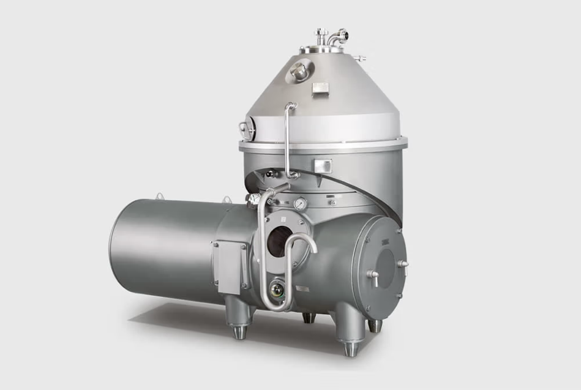
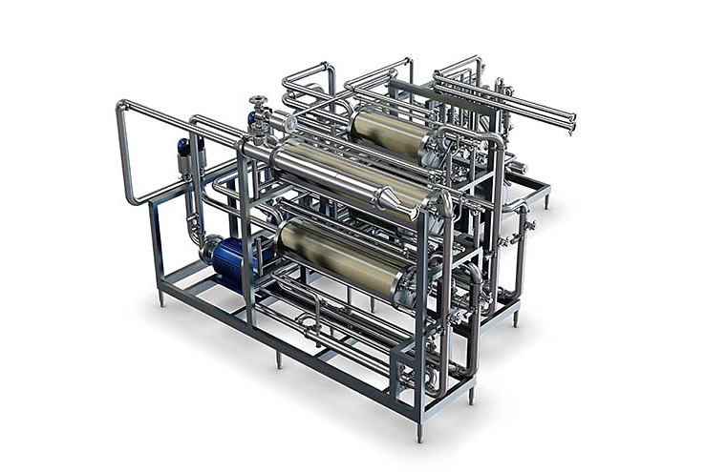
Commercial Scale Methods
Centrifugal Separation
Membrane Filtration

Slide 10
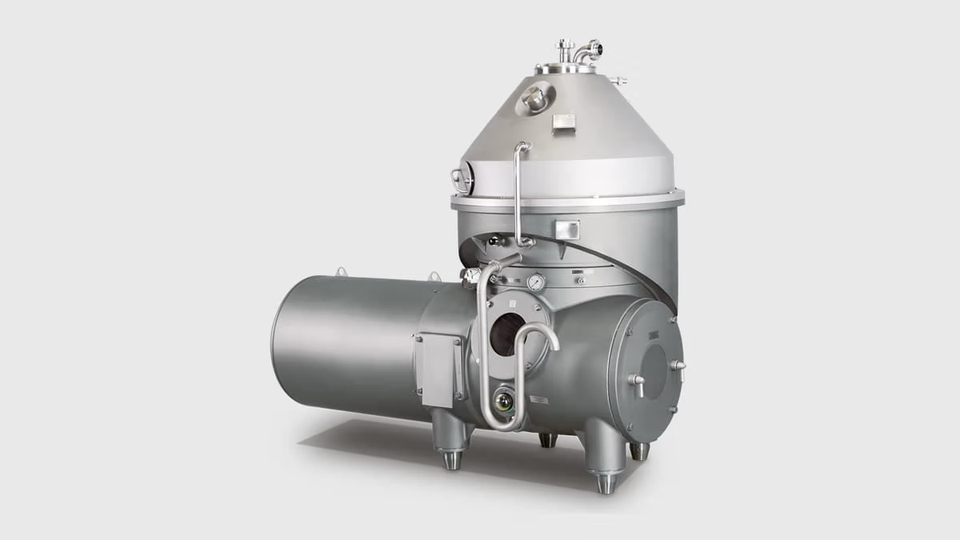
Centrifugal Separation

Slide 11
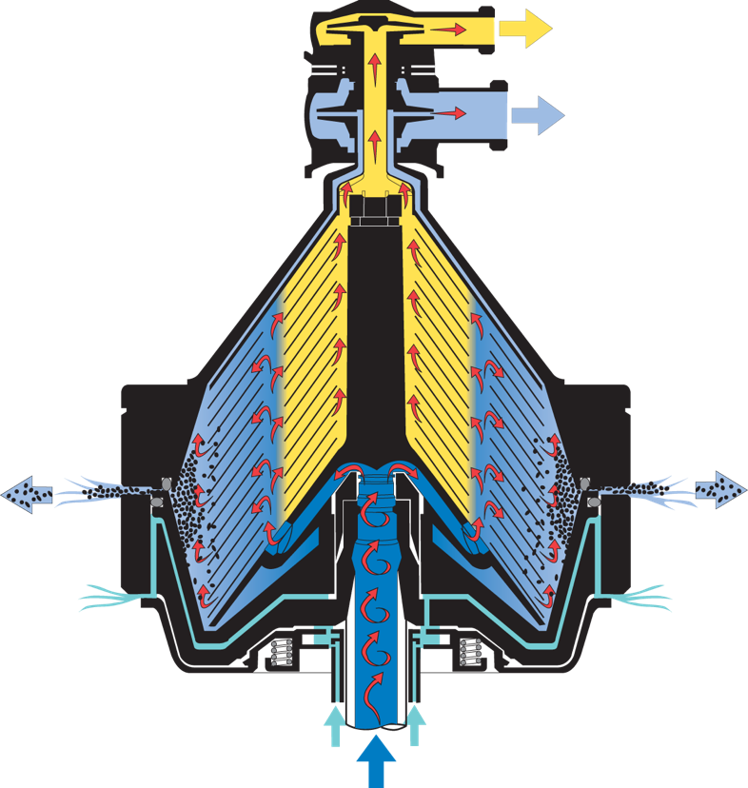
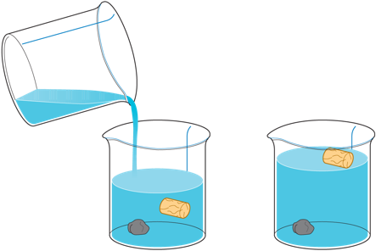
Principle Based on Density
Fat
Density of Dairy Components
Fat: 0.8918 g/cm³
Water: 1.0000 g/cm³
Casein Protein: 1.0632 g/cm³
Milk
Protein/Dense solids
Cream Doesn’t Want to Stay with Protein matrix.
Cream Wants To Go With Water.
Loss of cream when added prior to separation.
Cream leads to clogging of the nozzle separator and thus production stop.
Dairy Processing Handbook
Tetrapak
Fig 6.2.4 & 6.2.19

Slide 12
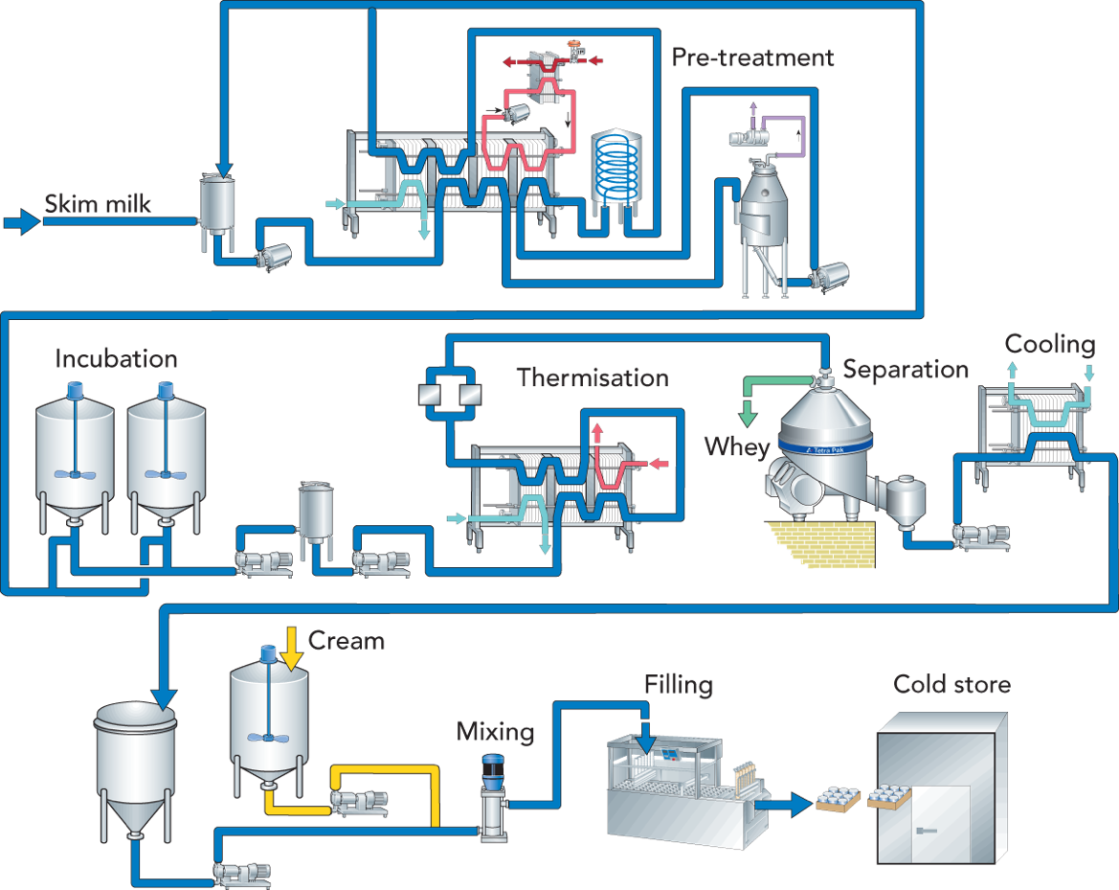
Concentration of Yogurt by centrifugal separator
This process flow has been used by many manufactures of Greek yogurt for decades to produce Greek yogurt US consumers are accustomed to.
Dairy Processing Handbook
Tetrapak
Fig 11.23

Slide 13
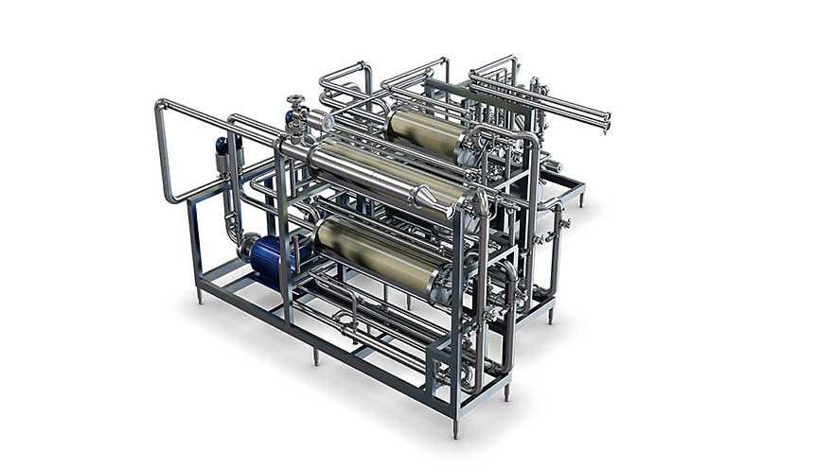
Membrane Filtration

Slide 14
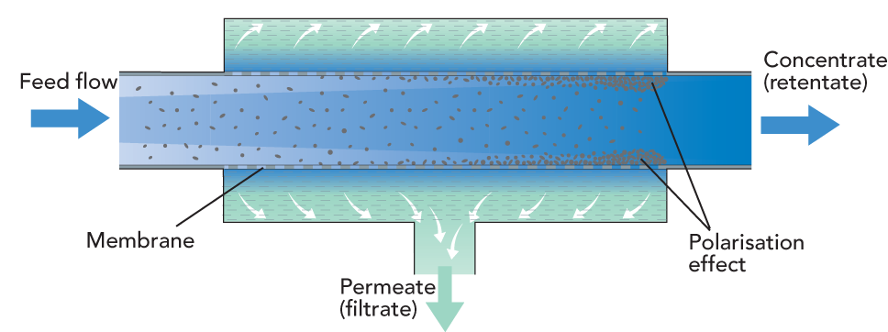
Principle: Based on Particle Size
Fat
Protein
Water
Cream readily goes with protein.
Water/Whey readily removed.
Cream does foul the membrane so run times can be shorter
Dairy Processing Handbook
Tetrapak
Fig 6.4.1 & 6.4.2 Modified

Slide 15
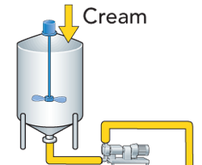
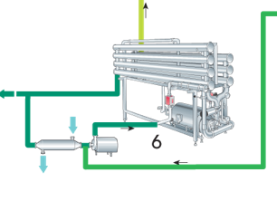
Membrane Filtration Allows For Multiple Setups
Dairy Processing Handbook
Tetrapak
Fig 11.23 Modified

Slide 16
Strained Yogurt Points Production
Separate addition of pasteurized dairy ingredients within the same facility is not an uncommon practice in modern dairy foods production (Milk for culture propagation)
Stored at <45 ºF and added inline
All Greek/strained yogurts meet the requirement of pH 4.6 within 24 hours of packaging.
Dairy Processing Handbook
Tetrapak
Fig 11.12 modified

Slide 17

Thank You

